Slide 1
Chemical Interactions in the Stability and Function of Biological Molecules
Shuchismita Dutta, Ph.D.
Collaborative Curriculum Development Program, 2014

Slide 2
Objectives
Central Dogma in Biology
Principles of Chemistry used in understanding Biology
  Review Atoms, bonds, molecules, macromolecules
Explore bio-molecular stability and interactions
  A few examples

Slide 3
The Central Dogma
Biology:
  DNA ➔ RNA ➔ Protein
Structural Biology
  Sequence ➔ Structure ➔ Function
Data
 | DNA | RNA | Protein
Sequence | GenBank | GenBank | UniProt
Structure | PDB/NDB | PDB/NDB | PDB
Function | Literature | Literature | Literature

Slide 4
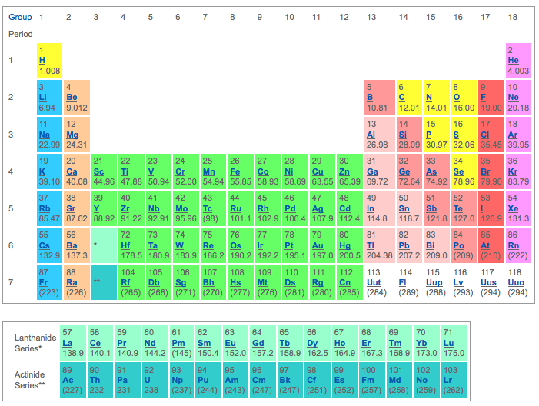
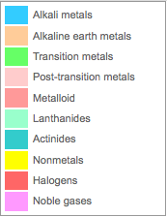
The Periodic table
http://periodic.lanl.gov/index.shtml

Slide 5
Elements in Biological Molecules
Elem-ent | General information | Chemical properties
C | Can form vast numbers and variety of compounds Vital to organic and life processes | Can form 4 covalent bonds Often seen in covalent interactions in hydrophobic regions
N | Critical for many biological molecules Ammonia (NH3) often the starting compound for many nitrogen compounds | Can form 3 covalent bonds Often seen in covalent or hydrogen-bonded interactions
O | Very reactive, combines with most elements Component of many organic compounds | Can form 2 covalent bonds
H | Binds to C, N, O atoms Not very reactive | Can form 1 covalent bond Participates in H-bonds
P | Very reactive Key element in energy currency in biology | Can form 3 or 5 covalent bonds
S | Similar to O Found in 2 essential amino acids | Can form 2 covalent bonds

Slide 6
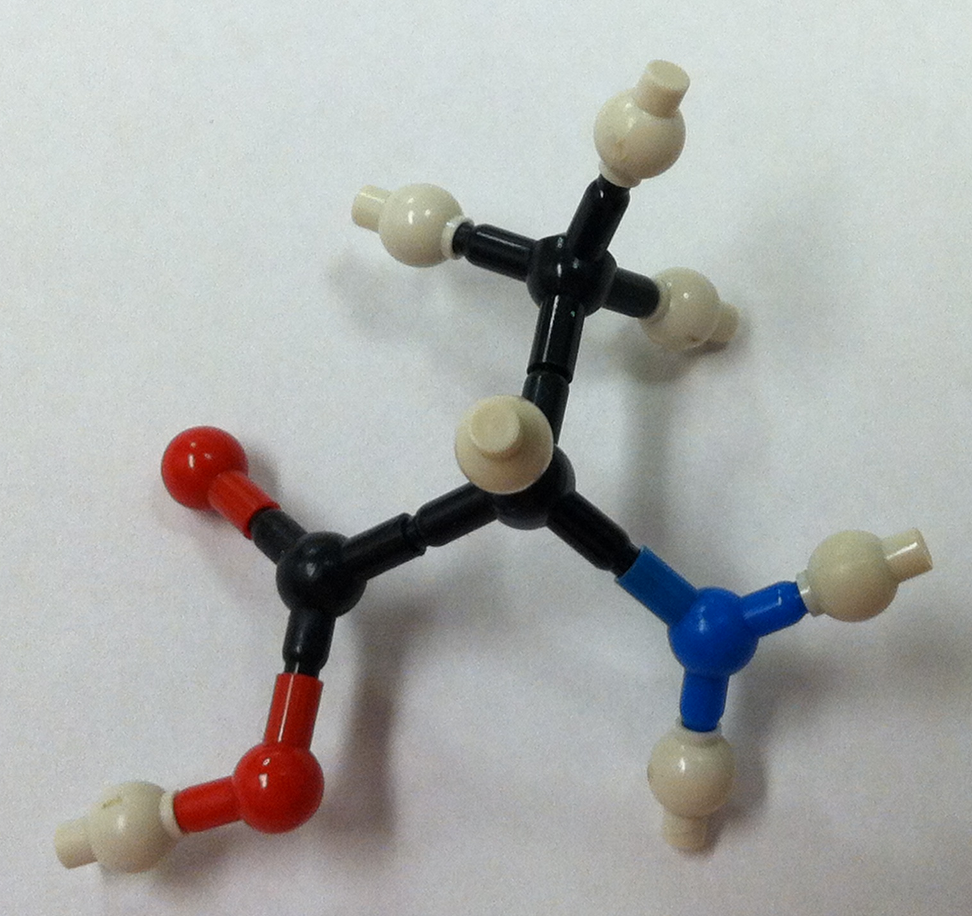
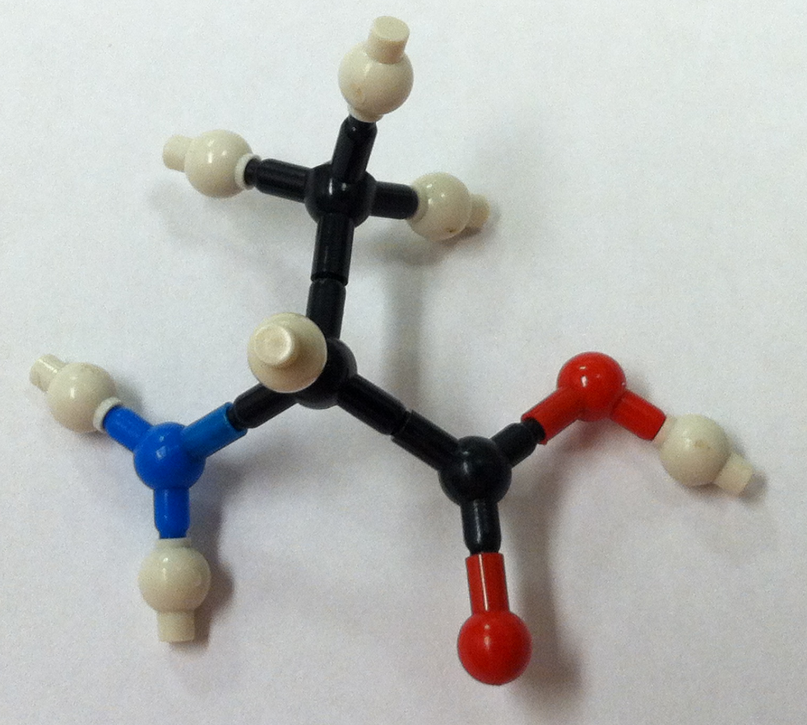
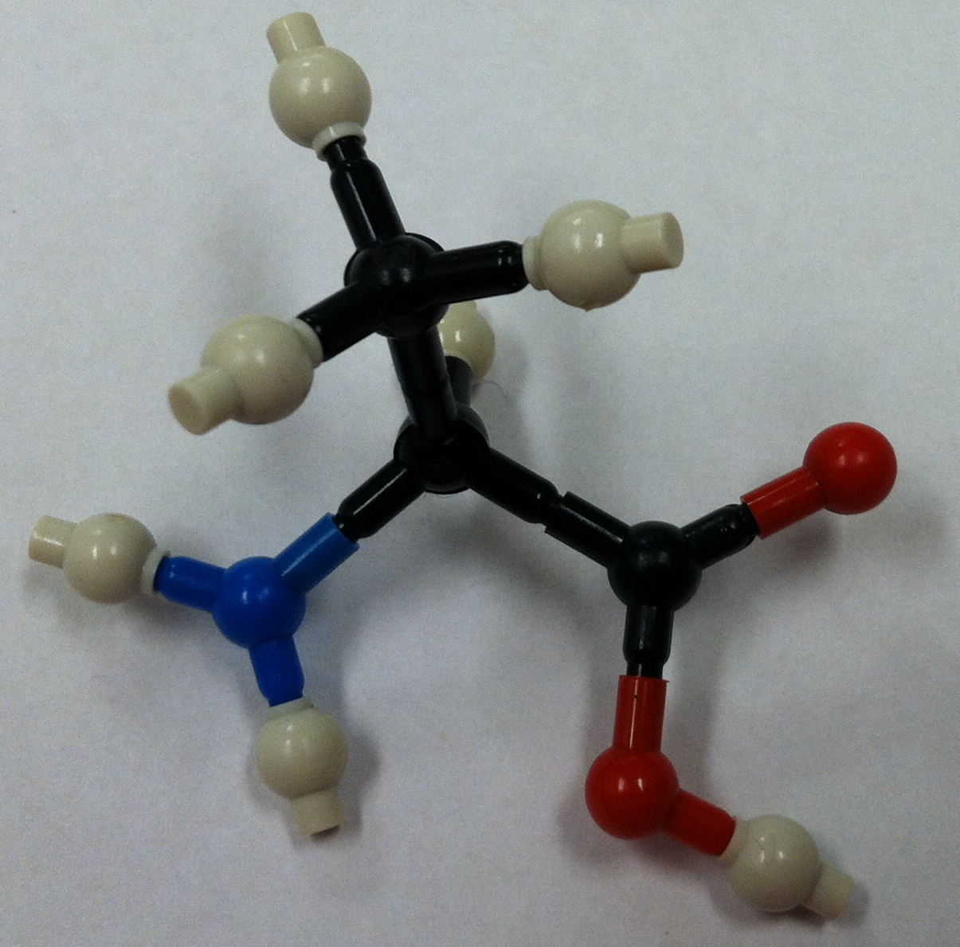
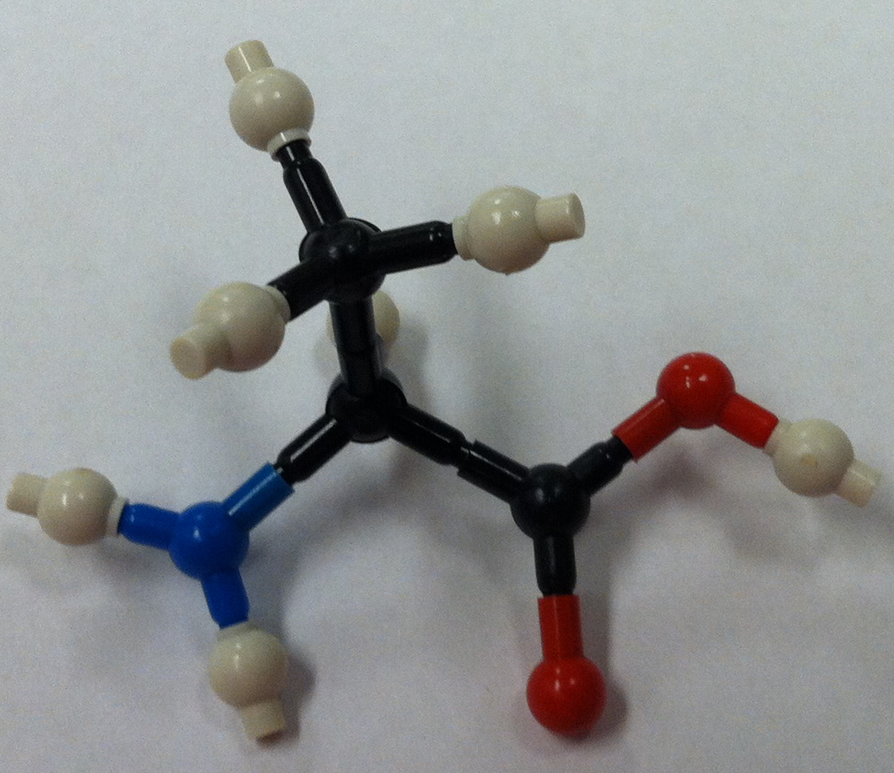
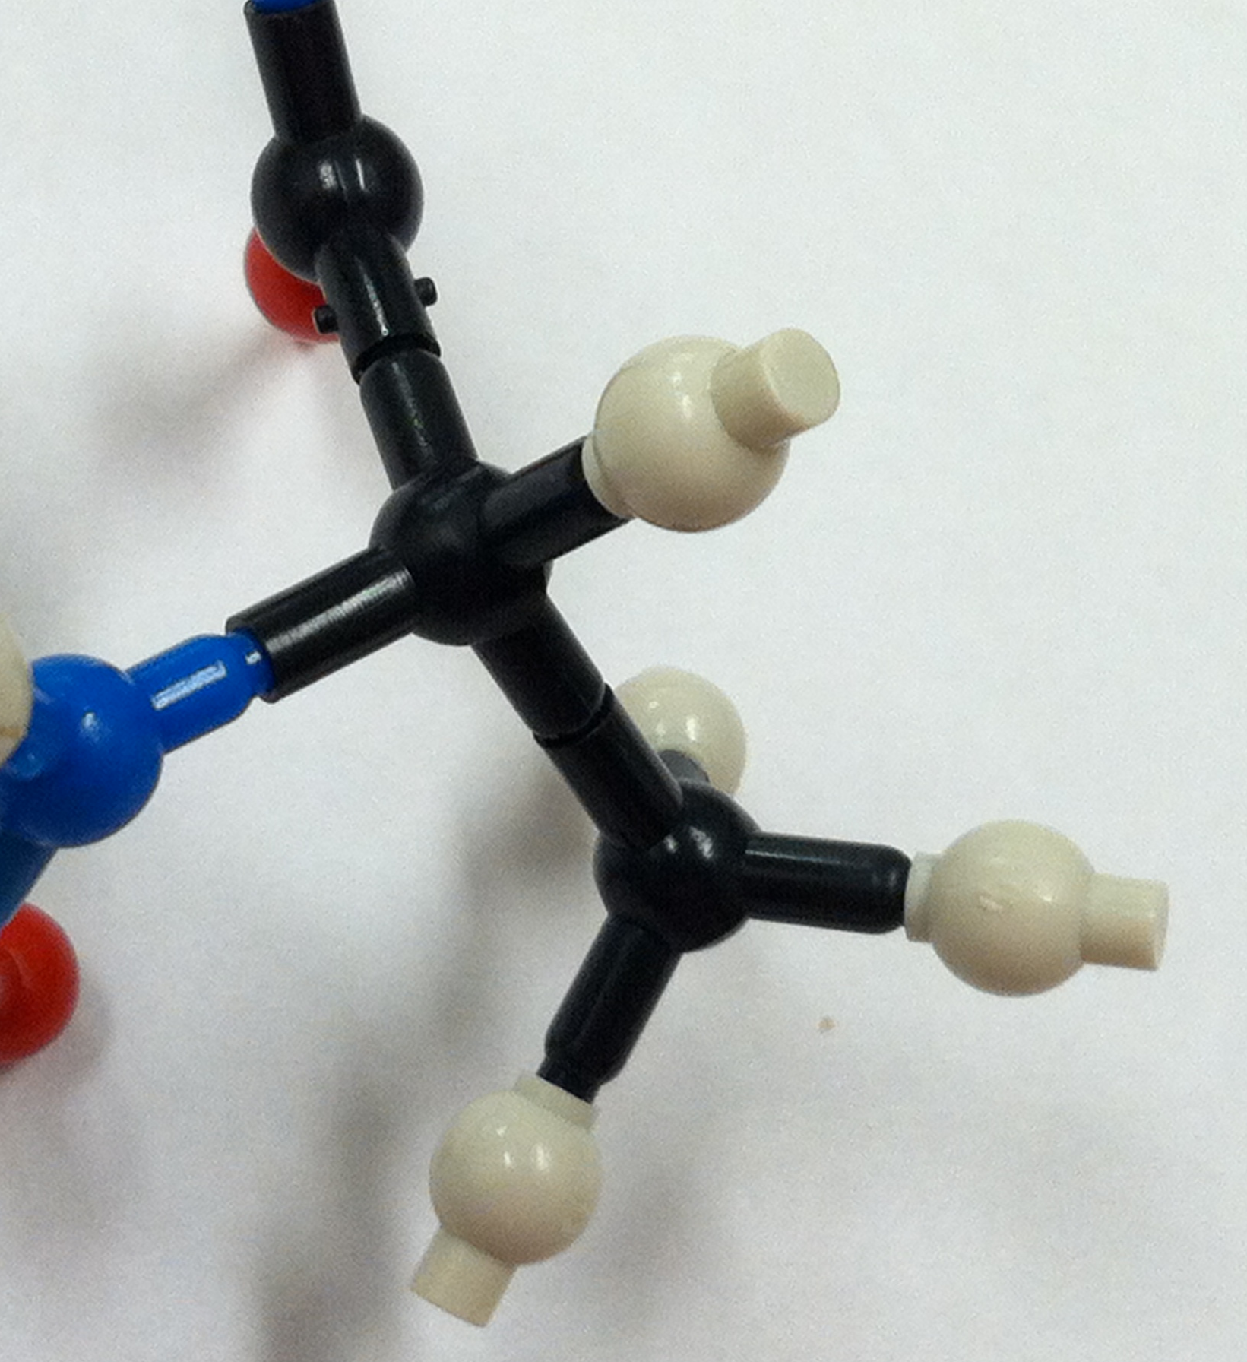
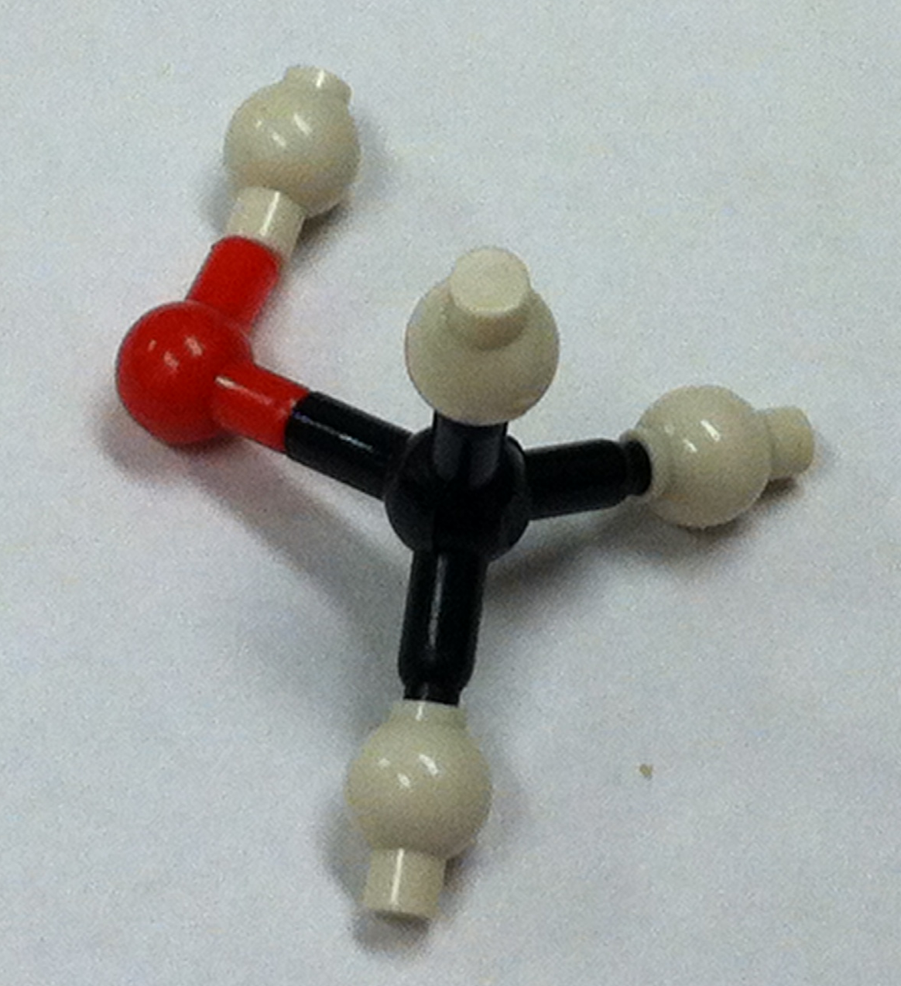
3Cs of Covalent Bonds
L-amino acid
D-amino acid
Configuration
Conformation:
Chirality
Spatial arrangement of atoms in a molecule – for example a carbon atom with four single bonds bonded to four different atoms/chemical groups shown here has different configurations. Changing configuration requires bond breakage. Configuration defines the molecule’s chemical reactivity and type of bonding it participates in.
Rotation
Rotation
Spatial arrangements of atoms in a molecule that can be obtained by rotation of the atoms about a single bond. No bond breakage required to change conformation.
Chiral
The property of a molecule that makes the molecule and its mirror image non-superimposable. If there are no chiral centers in the molecule the molecule is not chiral.
Not chiral

Slide 7
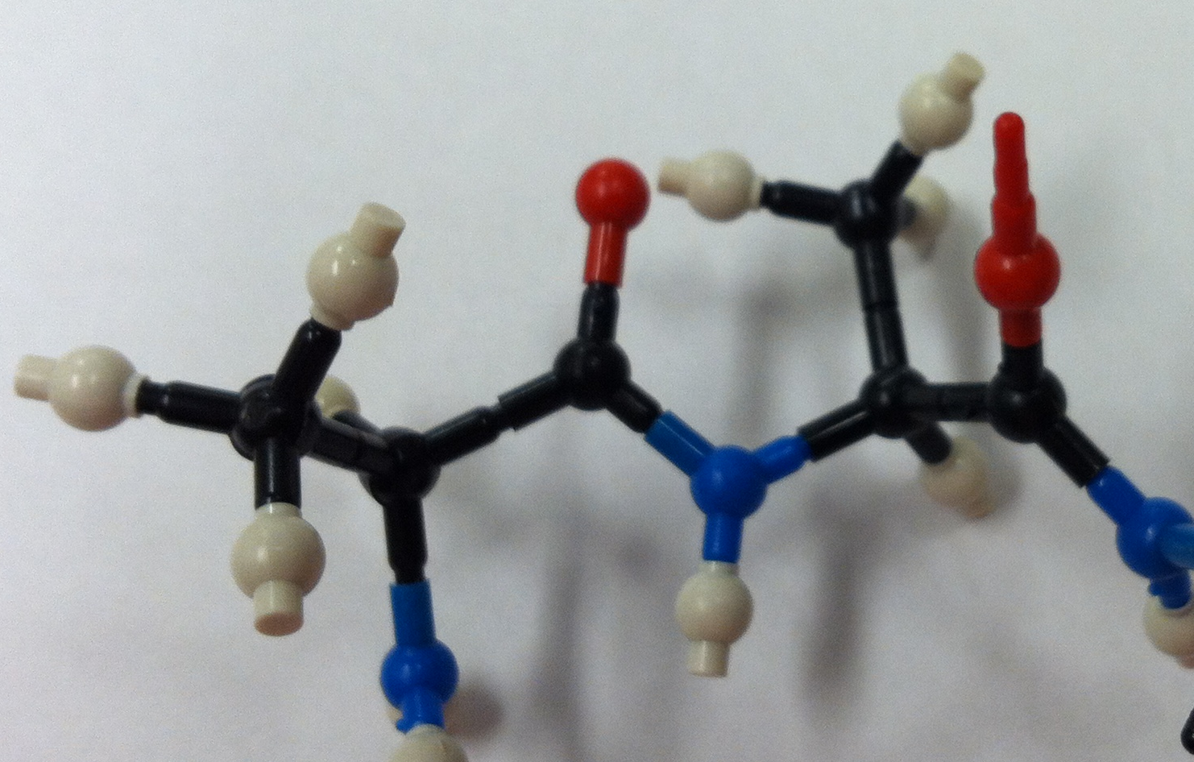
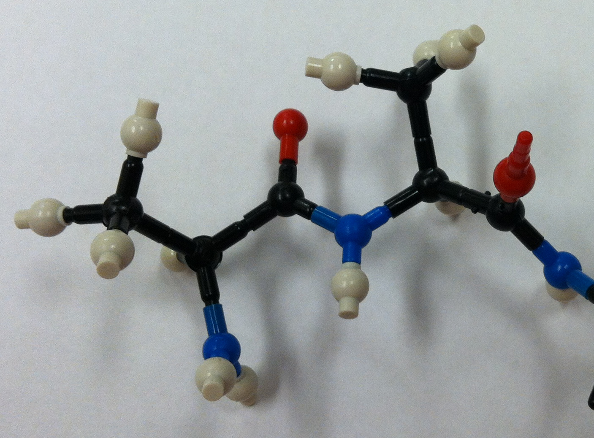
Why Do the 3Cs Matter?
Shape of biological molecules
  Folding
  Stability
Recognition and function of biological molecules
  Binding
  Interactions

Slide 8
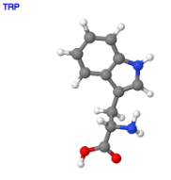
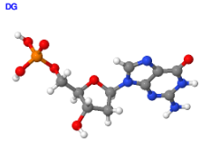
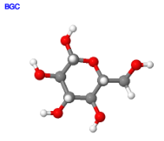
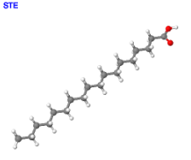
Macromolecular Building Blocks
Amino acids for Proteins
Nucleotides for Nucleic acids
Monosaccharides for Carbohydrates
Fatty acids for Lipids

Slide 9
Macromolecules: Composition and Function
Property | Protein | Nucleic Acid | Carbohydrates | Lipids
Atoms | C, H, N, O, S | C, H, O, P, N | C, H, O, N | C, H, O
Building blocks | Amino acids | Nucleotides | Simple sugars | Fatty acids, glycerol
Forms polymers?, type of bond | Yes, Peptide bonds | Yes, phosphodiester bonds | Yes, Glycosidic linkages – of various types | No, forms various di-, tri- Glycerides
Intra-molecular interactions | Covalent (S-S), H-bonds, charge based, van Der Waal’s | H-bonds, stacking interactions | H-bonds | Van Der Waal’s
Functional role in cells | Enzymes, structural proteins, sensors, receptors etc. | Storage of genetic information, enzymes, ribosomes | Storage of energy, structural, recognition, interactions | Membranes, signaling, energy storage, small molecule hormones

Slide 10
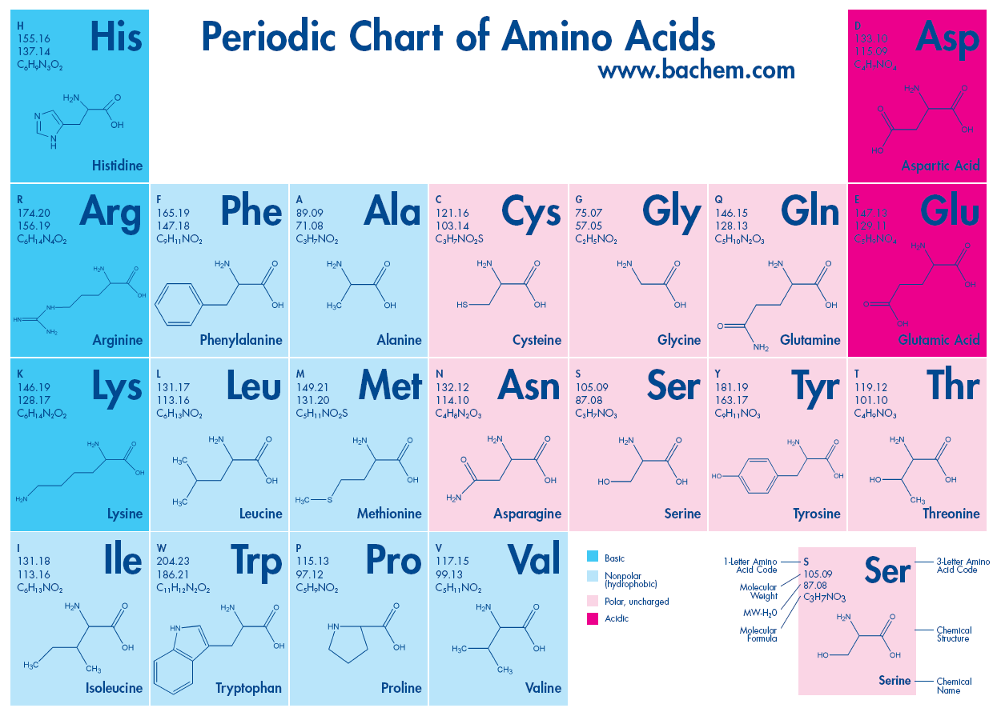
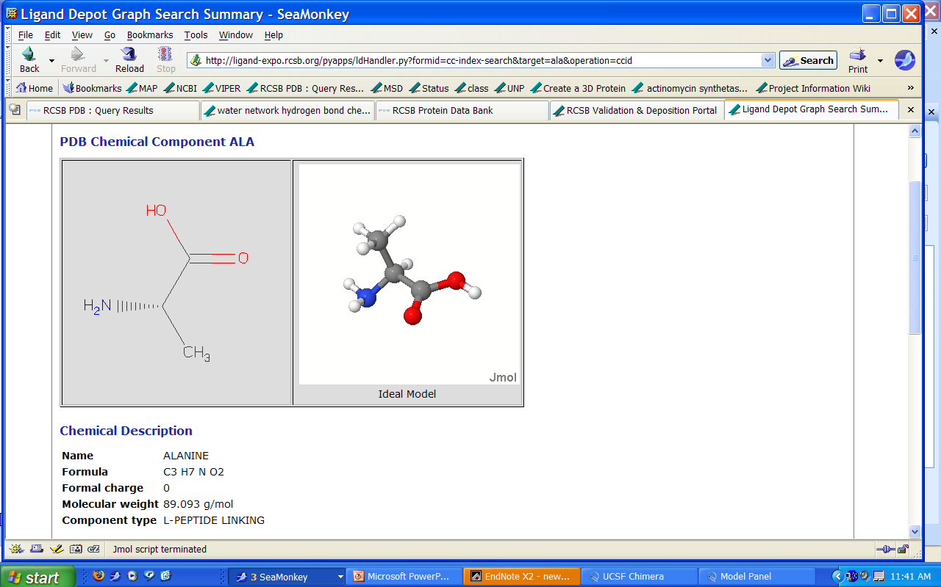
Protein Building Blocks: Amino Acids
Basic
Acidic
Hydrophobic
Hydrophilic
Side chain
C-alpha
Amino
group
Carboxyl
group
From www.bachem.com

Slide 11
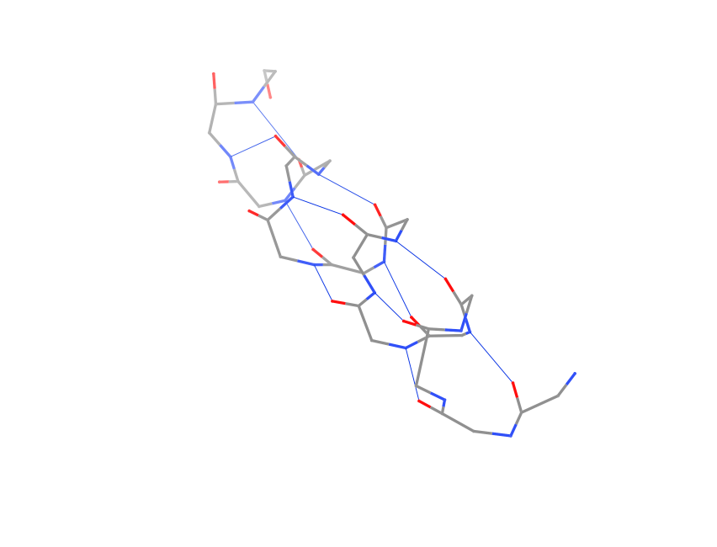
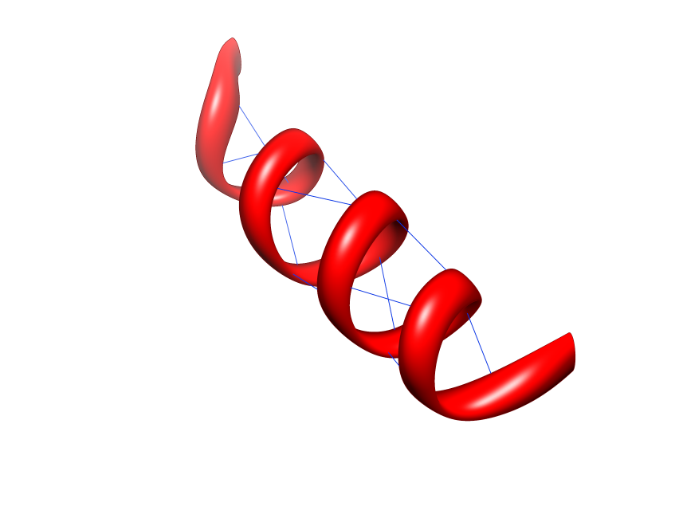
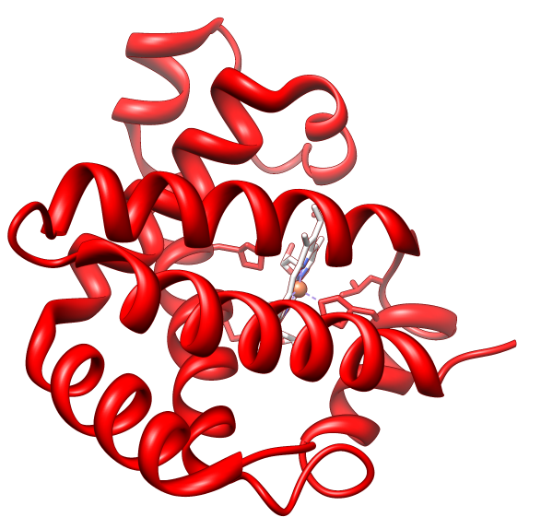
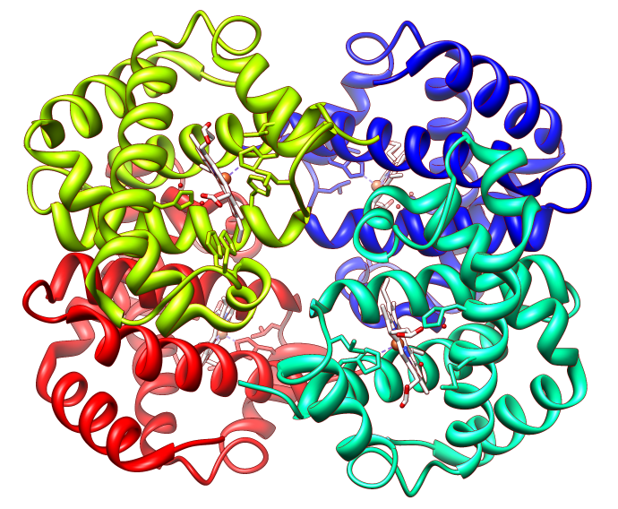
Four Levels of Protein Structure
Primary, 1º
  TPEEKSAVTALWGKV
Secondary, 2º
Tertiary, 3º
Quaternary, 4º
α2
α1
β2
β2
β1
Notes:
All images from 4hhb

Slide 12
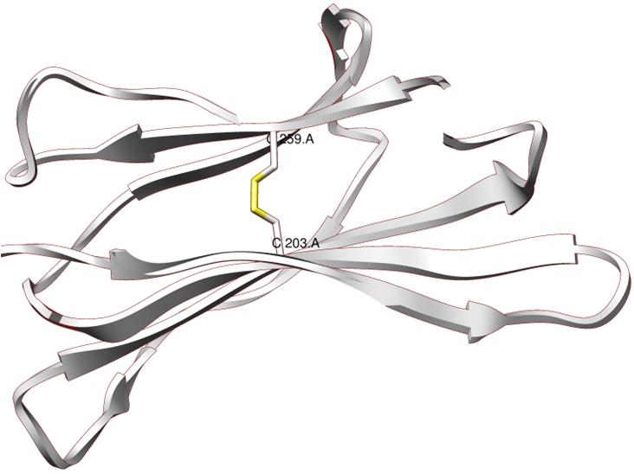
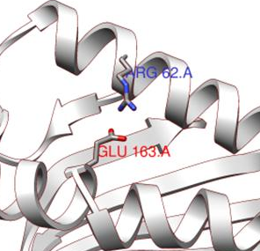
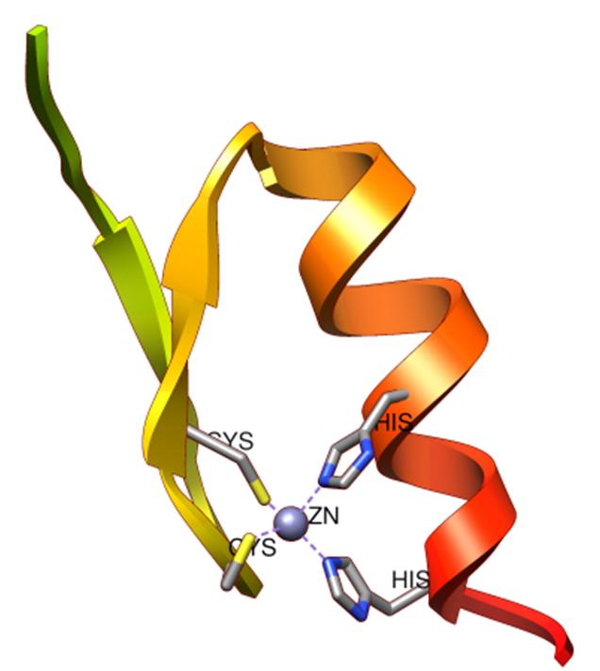
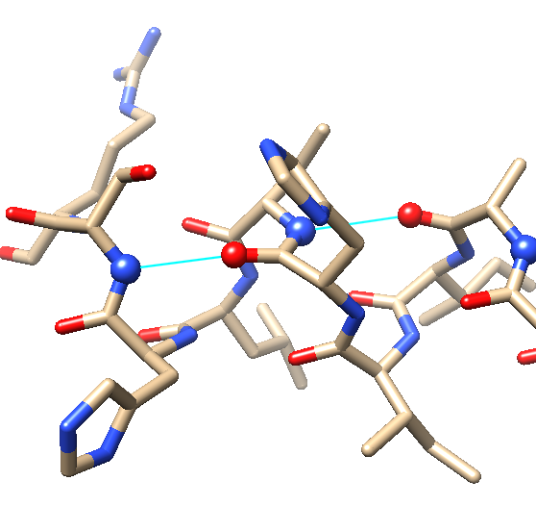
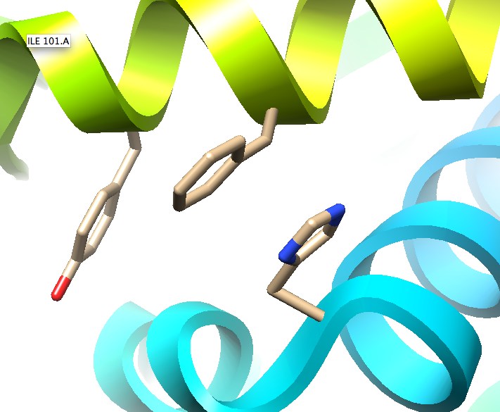
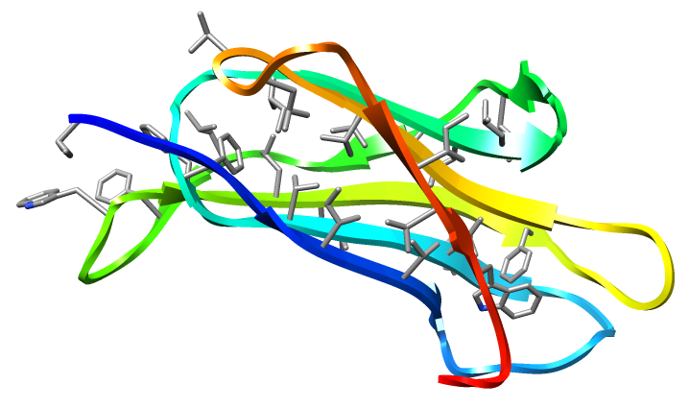
Interactions in Biological Molecules
Covalent Bonds
  Peptide
  Phospho-di-ester
  Disulfide
Non-covalent interactions
  Hydrogen bond
  Electrostatic/ionic
  Hydrophobic interactions
  van der Waal’s interactions
  Metal coordination
  Pi based interactions (stacking)
Ionic interactions
Metal Coordination
Disulfide bridge
H-bonds
Pi stacking
Hydrophobic interactions

Slide 13
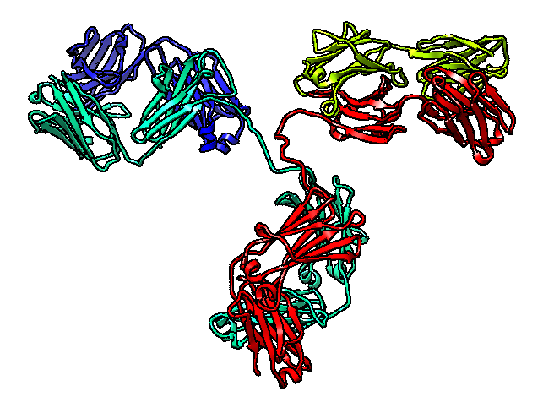
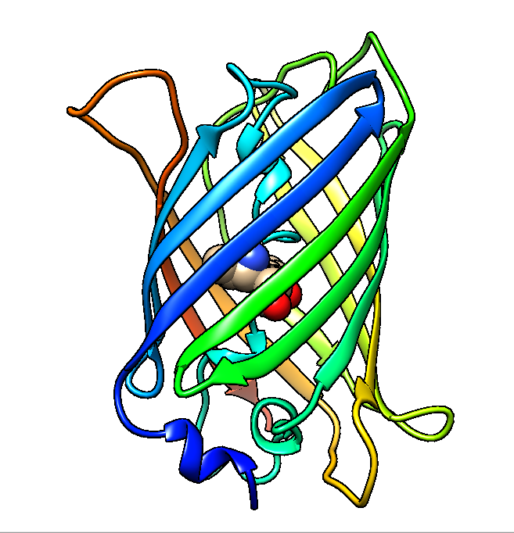
Protein Structure- Function:
Vocabulary check
Protein structure:
  Chain
  Motif
  Domain
  Oligomer – dimer, trimer etc.
Protein function:
  Binding
  Catalysis
  Regulation (switch on and off)
  Structural support/stability

Slide 14
What is Archived in the PDB?
Shuchismita Dutta, Ph.D.

Slide 15
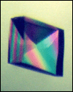
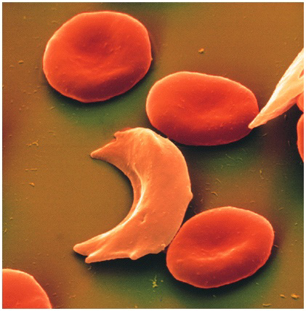

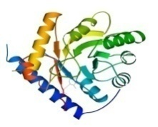
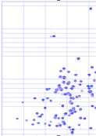
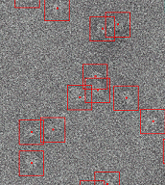
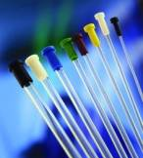

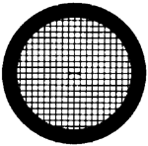

The Data Pipeline
Genomic
Based Target
Selection
Isolation,
Expression,
Purification,
Crystallization
Data
Collection
Structure
Determination
PDB Deposition
& Release
3D Models
Annotations
Publications
You come here
www.rcsb.org • info@rcsb.org

Slide 16
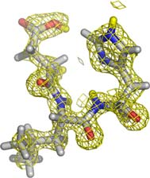
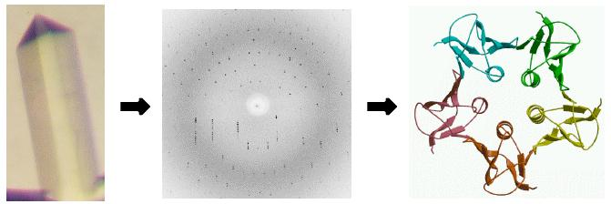
X-ray Crystallography
Target selection
Protein production
Crystallization
Structure calculation
Refinement
Validation
Deposition to PDB
Annotation
Data collection
Phasing
http://www-structmed.cimr.cam.ac.uk/Course/Overview/Overview.html#methods

Slide 17
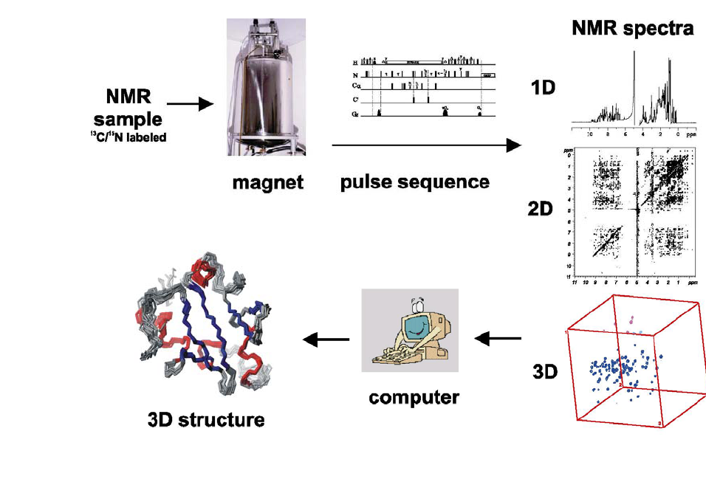
Nuclear Magnetic Resonance (NMR)
http://www.embl.de/nmr/sattler/teaching

Slide 18
Electron Microscopy (EM)
Courtesy, Cathy Lawson, Rutgers University

Slide 19
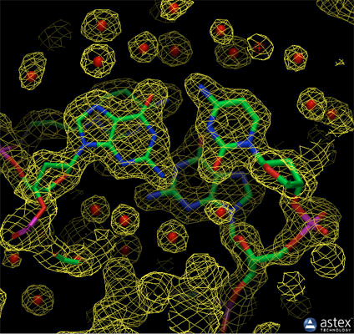
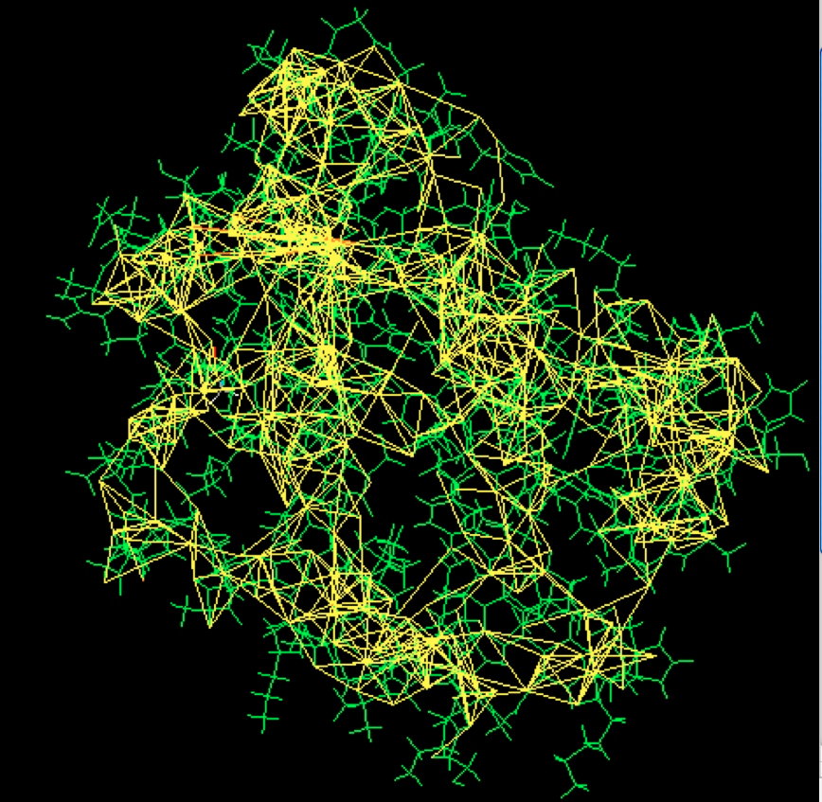
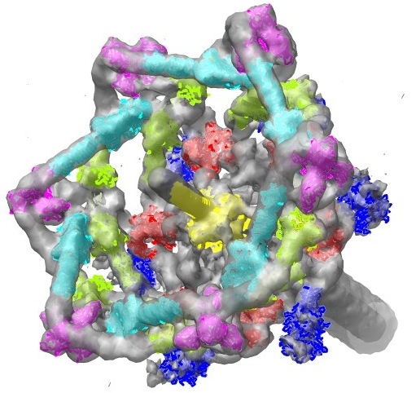
Experimental Data from Different Methods
X-ray Crystallography: Electron density from a structure of DNA is shown here (PDB entry 196d), along with the atomic model
NMR: Restraints used to solve the structure of a small monomeric hemoglobin. The protein (1vre and 1vrf) is shown in green, and restraints are shown in yellow.
EM: Tail of the T4 bacteriophage. Surface rendering of the EM data (emd-1048) with atomic coordinates from PDB entries 1pdf, 1pdi, 1pdl, 1pdm, 1pdp, and 2fl8.

Slide 20
What is in the PDB?
Coordinate and experimental data files
Details about sample preparation, data collection and structure solution
Sequence(s) of polymers (proteins and nucleic acids) in the structure
Information about ligands in the structure
Links to various resources that describe the sequence, function and other properties of the molecule.
Classification of structures by sequence, structure, function and other criteria
Download/Use directly
Link to/Find similar

Slide 21
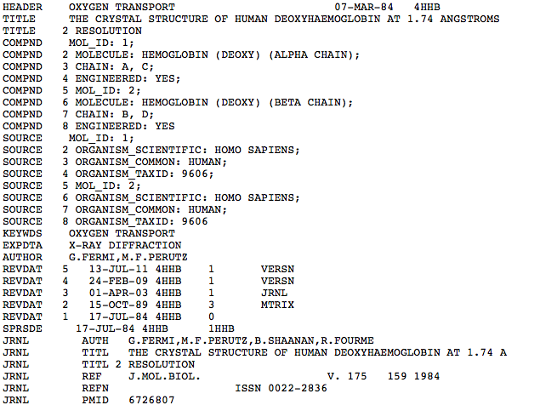
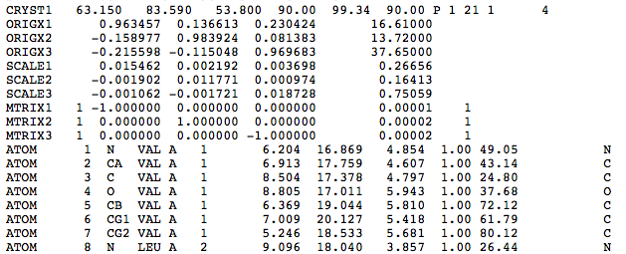
Meta data | Title Section
 | Primary Structure Section
 | Ligand Section
 | Secondary Structure Section
 | Connectivity Section
 | Miscellaneous Section
Coordinates | Origin and Transformations
 | Coordinates Section
End Section | Connectivity Section
 | Book-keeping Section
The PDB file
-snip-

Slide 22
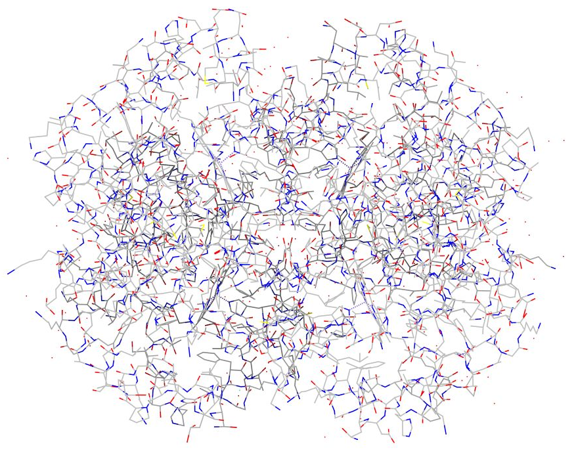
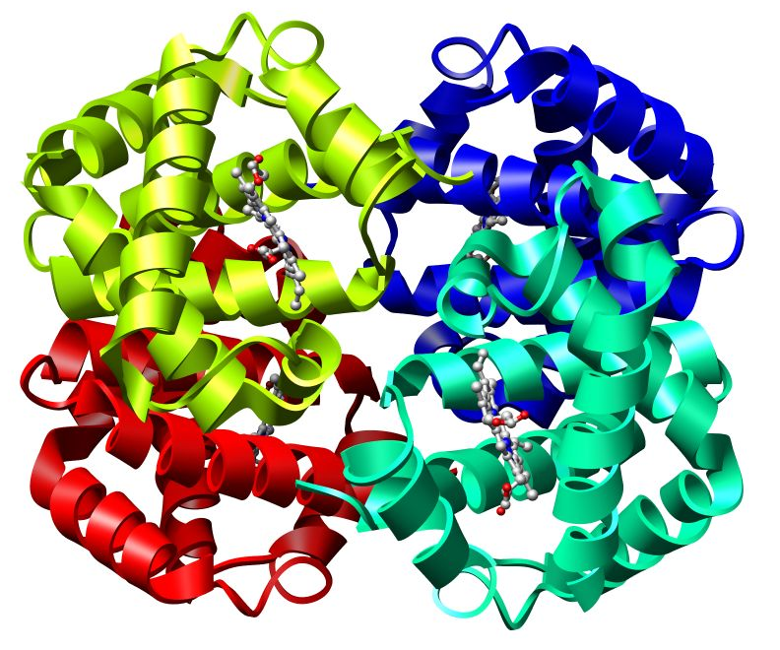
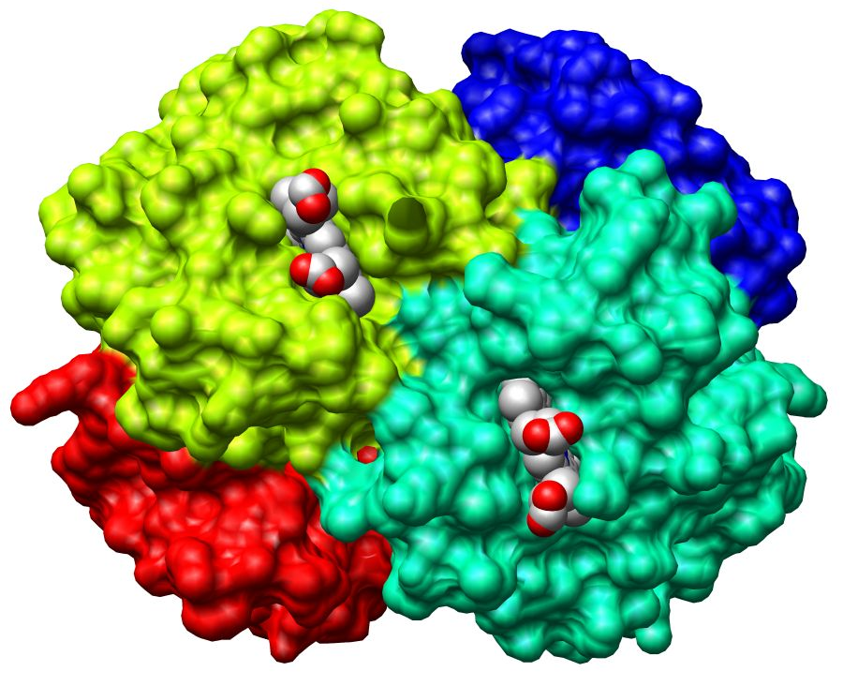
Visualization Conventions
Wireframe
Ribbons
All atoms seen
Only backbone C-alpha atoms seen
Spacefill
All atoms seen
Notes:
All structures drawn based on the structure of hemoglobin 4hhb

Slide 23
Summary
Central Dogma in Biology
  DNA > RNA > Protein
  Sequence > Structure > Function
Principles of Chemistry used in understanding Biology
  Review Atoms, bonds, molecules, macromolecules
Bio-molecular stability and interactions
  A few examples
What is in the PDB

